Slide 1
LIBRARY MANAGEMENT SYSTEM

Slide 2
INTRODUCTION:
A Library Management System (LMS) is a software application designed to manage the day-to-day operations of a library. It helps librarians, students, and other users to efficiently handle books, records, and transactions. Instead of maintaining paper registers, an LMS provides a digital platform that makes library activities faster, more accurate, and easier to manage.
Frontend: HTML + CSS + JavaScript (with Bootstrap)
Backend: PHP
Database: MySQL

Slide 3
STRUCTURE:
library-management/
├── index.php
├── books.php
(add/list/delete)
├── members.php
(add/list/delete)
├── borrow_book.php
├── return_book.php
├── borrow_list.php
├── return_list.php
├── db.php
├── navbar.php
(included in all pages)
├── lib.jpg
├── assets/
│ └── css/
│ └── style.css
├── sql/
│ └── library.sql
sample data)
├── README.md

Slide 4
Step-by-Step Process:
First we can see Library Management System Dashboard
In that dashboard we can observe the no.of books,members,
borrowers and returned
we can choose what we want…
First Books:
we can Enter Book Name, Author and copies and
Then click Add Book
In below display the Book details in list Table format.
Members:
we can add member Name and Email. Then click add member
borrow books:
In these we can choose the Member id and Book name
Then Click Borrow option
Returned book:
choose a book and Then select Return option
Then Book will be Returned.
Finally
It shows the Borrow list and Return list in Table format.
these is the process of these project

Slide 5
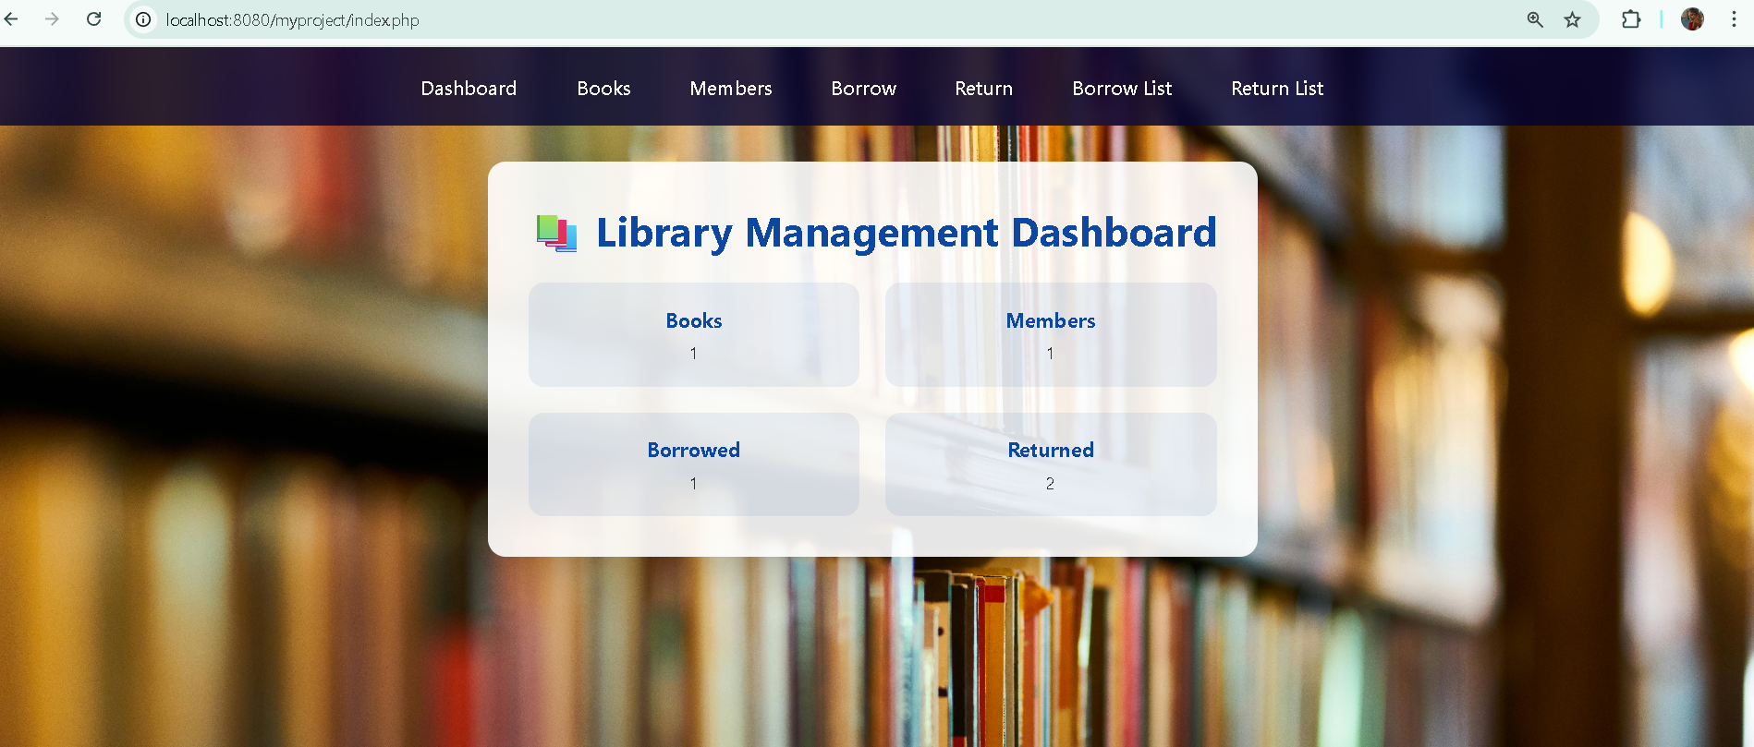
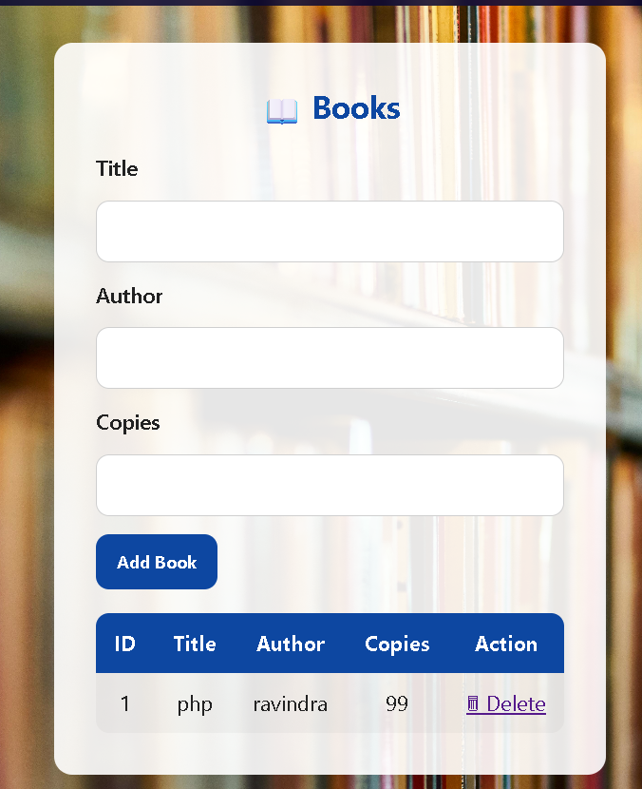
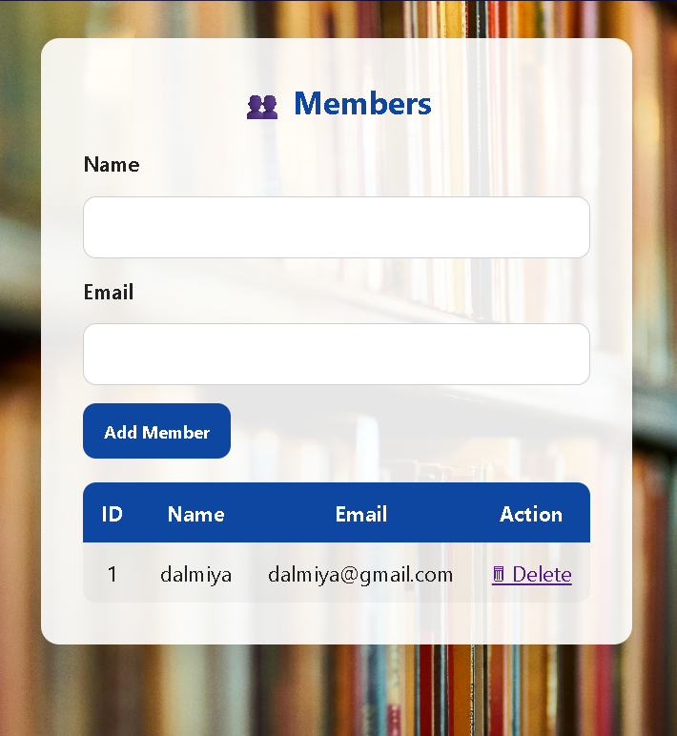
Sample Outputs:

Slide 6
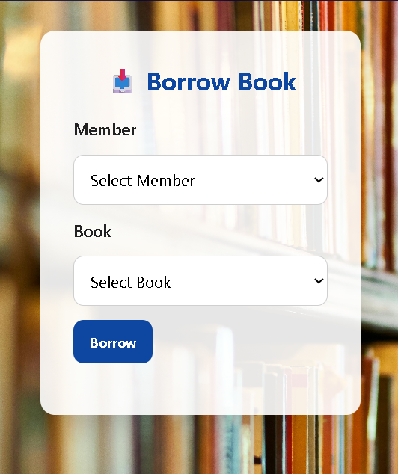
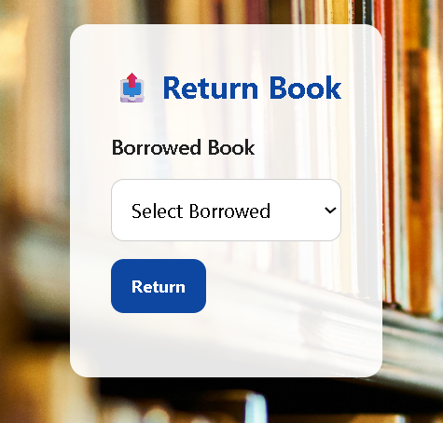
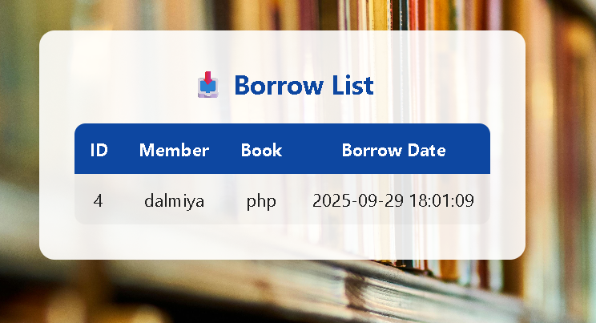
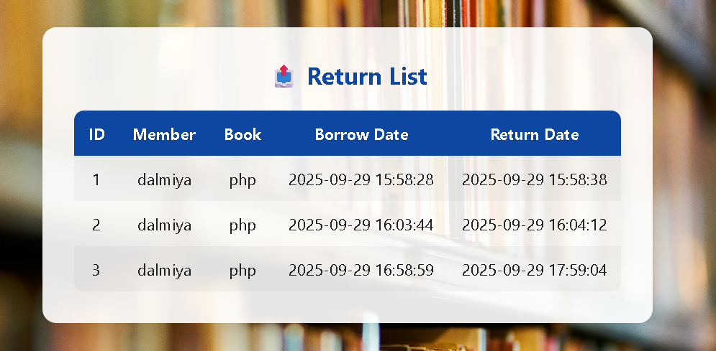

Slide 7
THANK YOU

